Slide 1
Prototyping

Slide 2
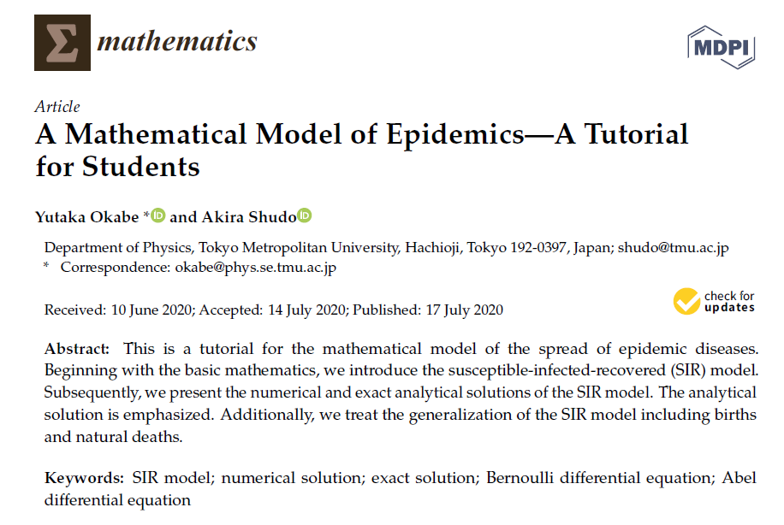

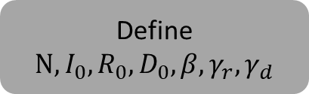

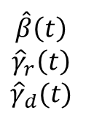
Define $N, I_{0}, R_{0},D_{0},β, γ_{r}, γ_{d}$
1
2
3
Numerical solution of the SIR model using a
Runge-Kutta method
(SIR.py)
Code extended to solve SIRD model numerically
(SIRD.py)
Simulated SIRD time series
Code to estimate parameters from surveillance data
(inverse.py)
$$\hat{β}\left(t\right)$$
$${\hat{γ}}_{r}\left(t\right)$$
$${\hat{γ}}_{d}(t)$$
Estimated parameters
$$N$$
$$I_{0}$$
$$R_{0}$$
$$D_{0}$$
5
4
Original and reconstructed SIRD series compared
(inverse.py)
Code to reconstruct the surveillance data from estimated params
(inverse.py)
Reconstructed SIRD time series

Slide 3
Testing with real data

Slide 4
Peddireddy or
IB-forward method
3
Surveillance data from Brasil.io
Preprocess time series from surveillance data
(preprocess.py)
Real SIRD time series
Code to estimate parameters from surveillance data
(inverse.py)
$$\hat{β}\left(t\right)$$
$${\hat{γ}}_{r}\left(t\right)$$
$${\hat{γ}}_{d}(t)$$
Estimated parameters
$$N$$
$$I_{0}$$
$$R_{0}$$
$$D_{0}$$
5
4
Original and reconstructed SIRD series compared
(inverse.py)
Code to reconstruct the surveillance data from estimated params
(inverse.py)
Reconstructed SIRD time series

